Slide 1
The first Hub for Developers
Azure DevOps
Charalampos Karypidis
Code.Learn:
.Net Academy

Slide 2

Agenda
Introduction to Azure DevOps environment
Overview of the different components
Present how a realy software project looks like

Slide 3








50% of Fortune 500 in 2000 now replaced by organizations that use technology to deliver customer value faster, better, and cheaper
The Fortune 500 of today face the same challenge tomorrow
Innosight
Corporate Longevity: Turbulence Ahead for Large Organizations
Notes:
Disruption affects every industry and no company is safe – we all have heard about the now classic examples of Blockbuster being ousted by Netflix, Lyft & Uber disrupting the traditional taxi industry, and even Twitter changing how we consume news and media.
Half of the companies that were on the Fortune 500 in 2000 are now gone, replaced by organizations that deliver value faster, better, and cheaper than the incumbents did – and the current Fortune 500 very much faces the same fate.
Technology plays a central role in the disruptors‘ ability to execute and out innovate their competition.

Slide 4
Product innovations need to reach customers quickly, and stay available
Accelerate
delivery
Optimize
reliability
Notes:
But, it’s not enough to have the worlds most efficient and collaborative developers
This code needs to be realized in functioning products that your customers can use
And these products and services need to be reliable, scalable and secure

Slide 5


Software delivery paradox
Speed vs. control impedes innovation
SPEED
Innovation
Reliability
CONTROL
Notes:
Traditional methods of delivering and operating software need re-thinking, especially in a cloud based world.
A business needs to move fast and innovate
But because of the manual nature of deployments and the siloed organizational structures, processes and tools – human error is inevitably introduced which leads to:
High failure rates when changes are implemented and
Long times to recover from outages
In a bid to improve reliability in these situations, we traditionally implement further controls – via more manual processes, and approval gates.
But, this doesn’t improve overall system reliability, and merely introduces:
Long lead times for changes and
Low deployment frequency

Slide 6
Developers are at the heart of your company’s innovation
Increase productivity
Accelerate collaboration
Notes:
In a technology driven world, developers are at the heart of your company’s future innovation endeavors
From those first lines of code, how do you give your developers the best tools to unleash their capabilities and make them their most productive selves.
But productivity doesn’t just come from great tools, your also need to facilitate collaboration and code re-use across teams
This accelerates problem solving and focuses efforts on solving new problems important to your business, versus those that have already been solved by others.

Slide 7
Accelerating Delivery with DevOps
Develop
“
DevOps is the union of people, process, and products to enable continuous delivery of value to your end users.
”
DevOps
Operate
Deliver
Notes:
DevOps allows us to accelerate delivery, while still delivering reliable products and services
This is about bringing people together, through shared common goals, increased collaboration and a focus on improvement
Technology plays a key role in helping to execute a DevOps strategy by enabling teams to collaborate more, enhance productivity, facilitate experimentation and automate their processes from development, through to delivery and operations
It’s also about delivering value faster by increasing efficiency, eliminating waste and streamlining feedback back to developers to continuously improve the product
The result: better products, delivered faster, to happier customers
https://medium.com/@DonovanBrown_41367/dissecting-the-definition-69151da0435f

Slide 8
Innovation with oversight
Time spent
50%
Top performing DevOps companies spend more time innovating and less time “keeping the lights on”.
The result: better products, delivered faster, to happier customers by more engaged teams
30%
19.5%
20%
20%
15%
10%
10%
5%
5%
Top DevOps Performers
Low DevOps Performers
Notes:
According the 2018 State of DevOps Report, presented by DORA, the top performing DevOps companies when compared to low performers spend:
66% less time on customers support issues
50% less time on customer identified defects and remediation of security issues
More importantly they spend 66% more time on new work
They spend more time innovating, and less time keeping the lights on – enabling them to be more adaptive in their markets and disrupt their competitors

Slide 9
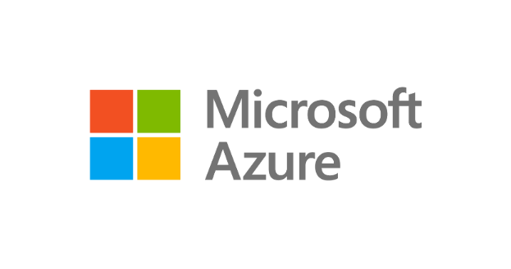
Develop
GitHub
Visual Studio
Visual Studio Code
Innovate at scale.
Deliver with confidence.
Microsoft Azure is the cloud with DevOps tooling built in
Deliver
Operate
Azure Boards
Azure Repos
Azure Pipelines
Azure Artifacts
Azure Test Plans
Azure Lab Services
Azure Monitor
Azure Policy
Azure Automation
Azure Security Center
Notes:
So, we’ve just run through our overall solution and how this addresses all four areas that enable you to innovate at scale, and deliver with confidence. We looked at how you can use:
Visual Studio and Visual Studio code to maximize developer efficiency
GitHub to accelerate collaboration and open source development practices
Azure DevOps to accelerate delivery of your products and
Azure Security & Management services to ensure your products operate reliably, scale and remain secure

Slide 10





Deliver
with Azure DevOps
Azure Boards
Azure Repos
Azure Pipelines
Azure Artifacts
Azure Test Plans

Slide 11
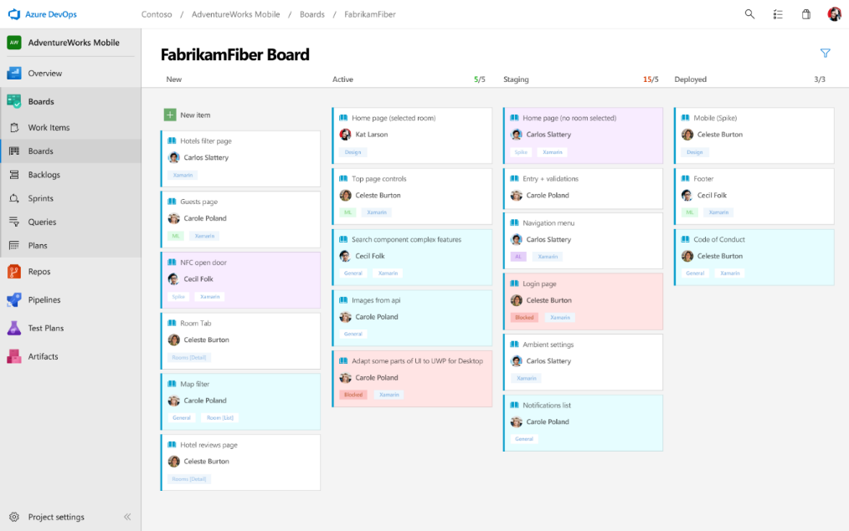
Deliver
Azure Boards
Azure Repos
Azure Pipelines
Connecting ideas to releases
Scrum ready to help your teams run sprints, stand-ups, and plan work
Integrated with GitHub commits and pull requests
Insights into project status and health
Azure Artifacts
Azure Test Plans

Slide 12
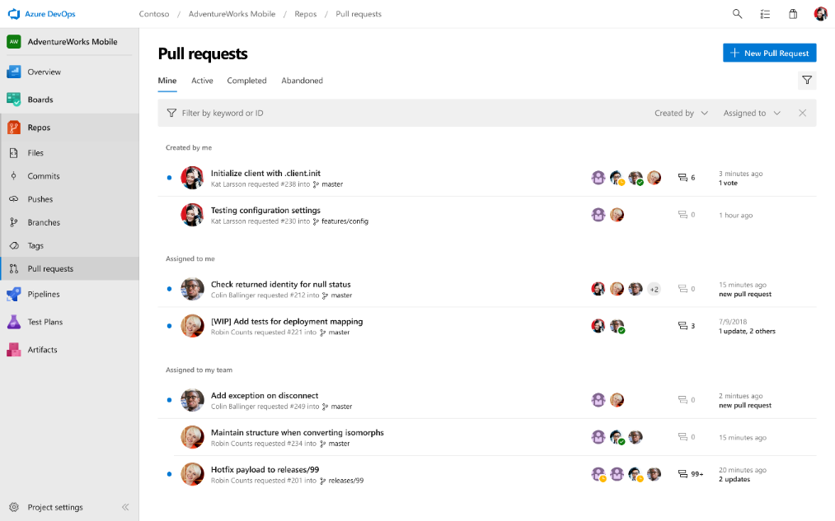
Deliver
Azure Boards
Azure Repos
Azure Pipelines
Private Git and TFVC repos for your teams
Code review via branch pull requests
Branch policies and build validation
Easy migration path to / from GitHub
Azure Artifacts
Azure Test Plans

Slide 13
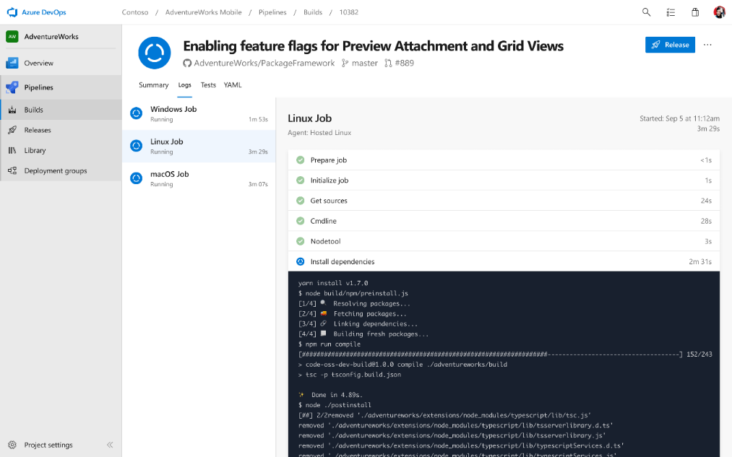
Deliver
Azure Boards
Azure Repos
Azure Pipelines
Cloud-hosted pipelines for Linux, macOS and Windows
Any language, any platform, any cloud
Native support for containers and Kubernetes
Best-in-class for open source
Azure Artifacts
Azure Test Plans

Slide 14
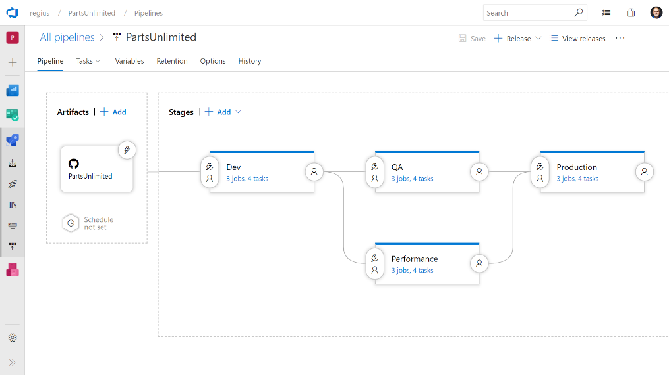
Deliver
Azure Boards
Azure Repos
Azure Pipelines
Deploy to on-premises, ANY cloud or a hybrid of cloud and on-prem
Staged environment releases
Pre and post deployment approvals with gates to automate approval based on conditions
Azure Artifacts
Azure Test Plans

Slide 15
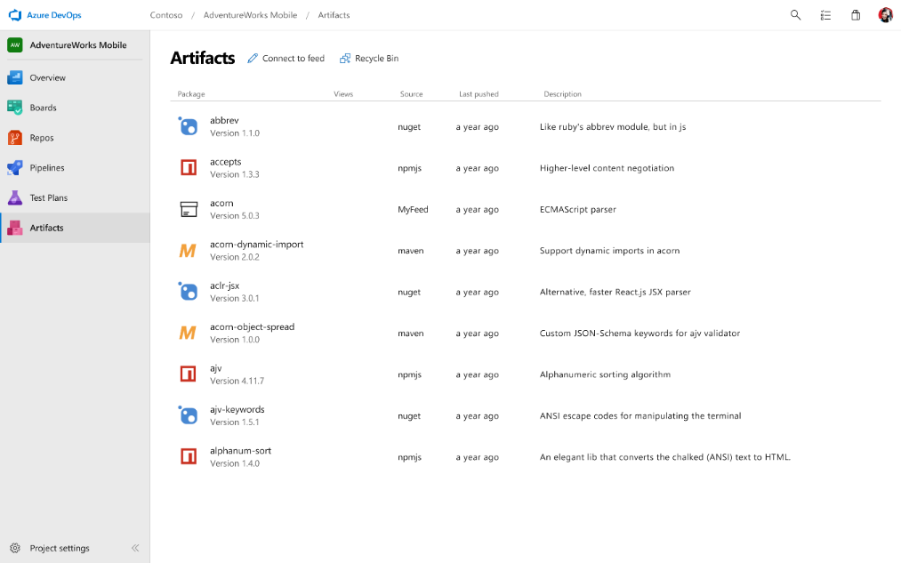
Deliver
Azure Boards
Azure Repos
Azure Pipelines
Share code efficiently
Keep your Maven, npm, NuGet and Python packages and more in the same place
Aggregate from public registries and internal teams
Publish and track from any pipeline
Azure Artifacts
Azure Test Plans

Slide 16
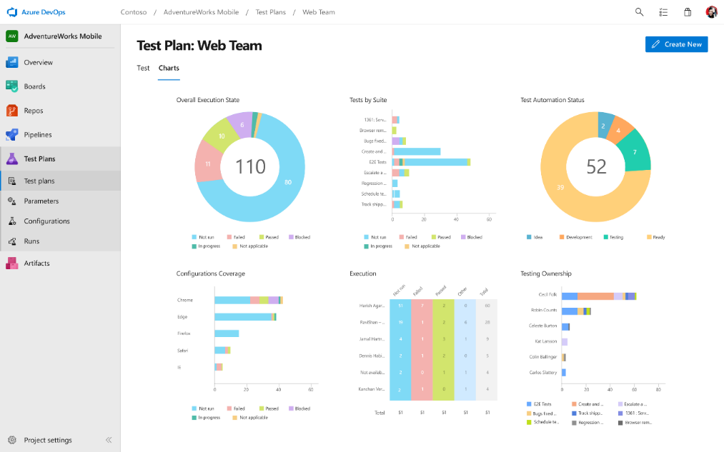
Deliver
Azure Boards
Azure Repos
Azure Pipelines
Run tests and log defects from your browser
Track and assess quality throughout your lifecycle
Capture rich data for reproducibility
Create tests directly from exploratory sessions
Azure Artifacts
Azure Test Plans

Slide 17




Azure DevOps supports small teams and the largest enterprises
Instead of telling people to wait for 6 months for a new feature, we can give it to them in a few weeks…Our 2800 worldwide developers can use the same backlog, user stories and tests whether they’re on Windows or Linux… building for iOS or Android.
Speed is gained in moving to the PaaS offering of Azure DevOps. PaaS provides regularly released features and a future-proof capability, eliminating the need for Accenture to maintain infrastructure and go through upgrade cycles.
“
“
”
”
Microsoft made it really easy to break outside the silos… and tie the DevOps process into the fulfilment of business process. Without the tools that we have today, we would not be successful.
Branches sync 500 percent faster. Builds are 400 percent faster, with the typically six-hour process reduced to 90 minutes. We (now have) a highly streamlined process that operates with a few button clicks—and one-button deployment.
“
“
”
”

Slide 18
DevOps at Microsoft
Azure DevOps is the toolchain of choice for Microsoft engineering with over 100,000 internal users
➔
https://aka.ms/DevOpsAtMicrosoft
442k
Pull Requests per month
4.6m
Builds per month
28k
Work items created per day
82,000
Deployments per day
2.4m
Private Git commits per month
3.5k Open Source repos
12k
Employees contributing to open source
Data: Internal Microsoft engineering system activity, March 2019
Notes:
Enterprise scale

Slide 19
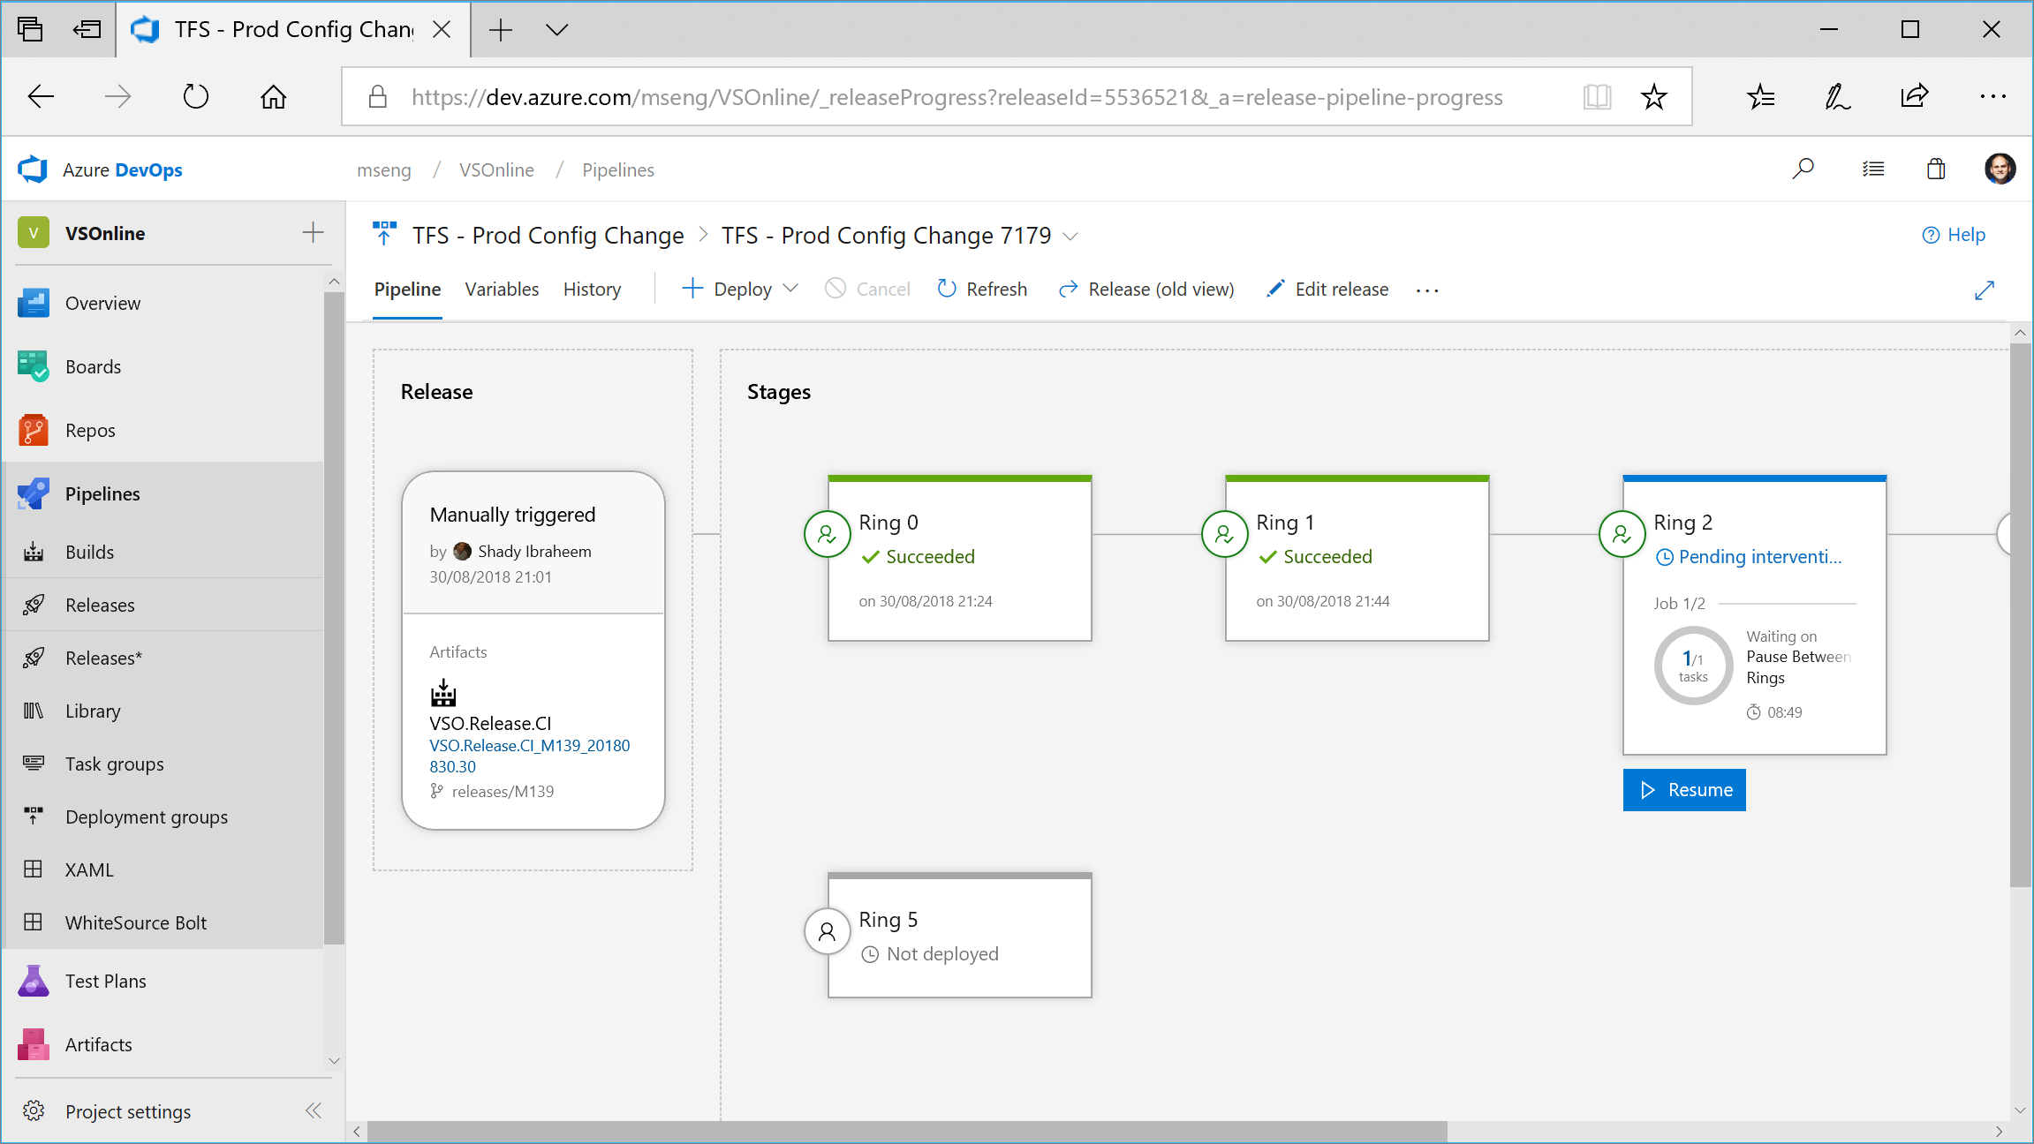
Notes:
We use Azure DevOps to deploy Azure DevOps (and build and deploy all the large products in Microsoft, from Windows to Office, Minecraft to Teams)

Slide 20
Global Reach
Azure DevOps has more global regions than any other cloud provider

